Slide 1
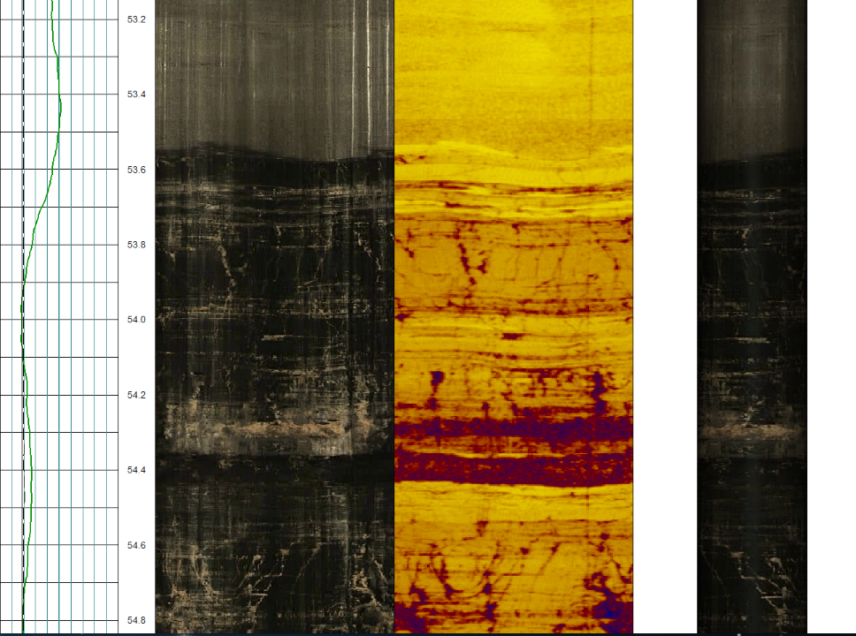
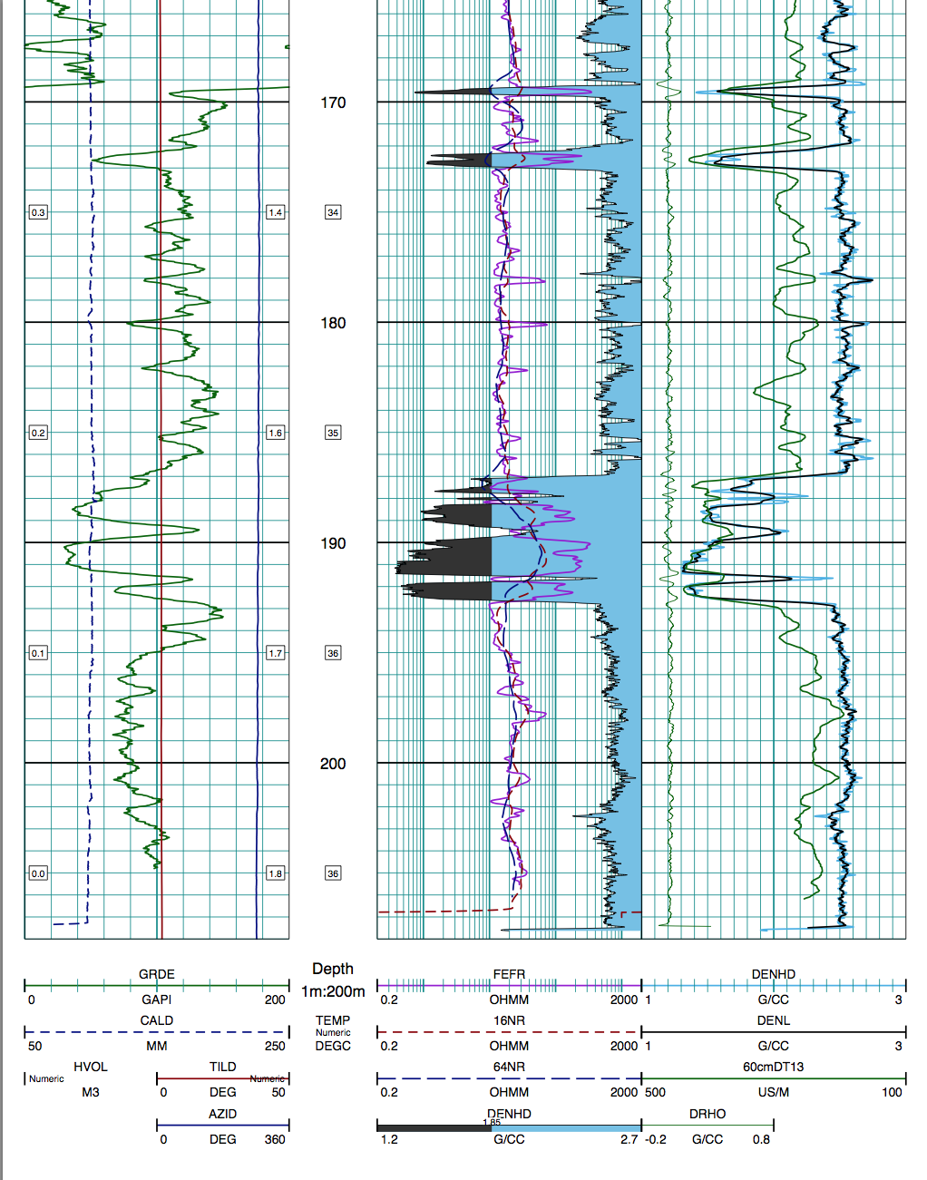


Applications of wireline geophysics
in iron ore evaluation

Slide 2

Why do we log?
        To provide support for testing of surface geophysical anomalies
        To aid lithology and stratigraphic interpretation
        To provide information to help constrain resource models (survey and density)
        To provide physical property information to assist with geotechnical and hydrogeological studies
        Potentially, to assist with mining grade control.

Slide 3
Iron Ore logging toolkit
        Gyro
        Natural gamma
        Magnetic susceptibility
        Gamma density and caliper
        Resistivity
        Optical televiewer
        Acoustic televiewer
        Neutron
        Full Waveform Sonic log
        Nuclear Magnetic Resonance
“Standard”
Iron Suite
Commonly used
imaging tools
Specialized
applications

Slide 4
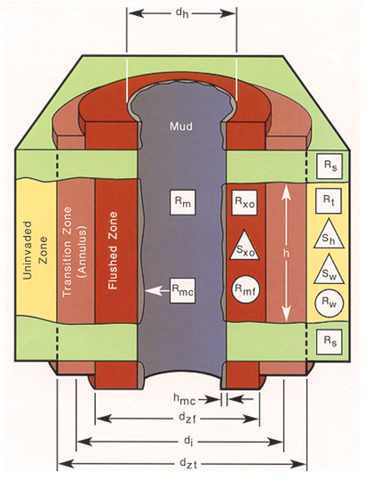
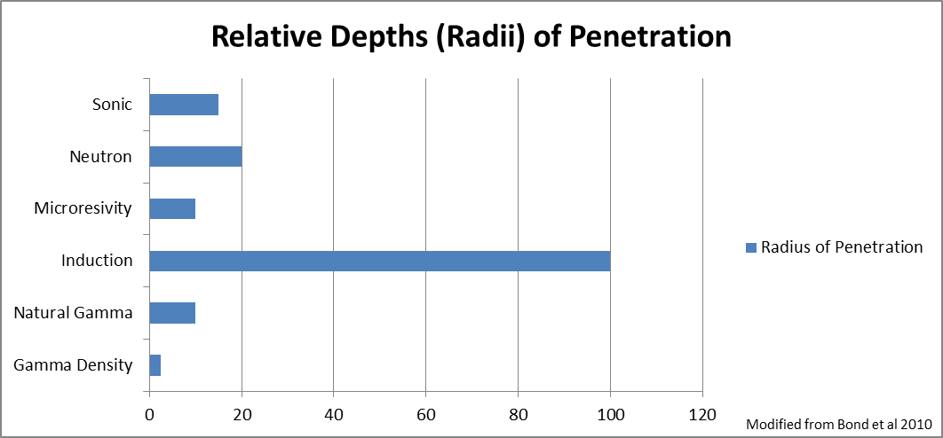
Logging measures rock properties outside the borehole wall …
… and drilling induced effects.

Slide 5
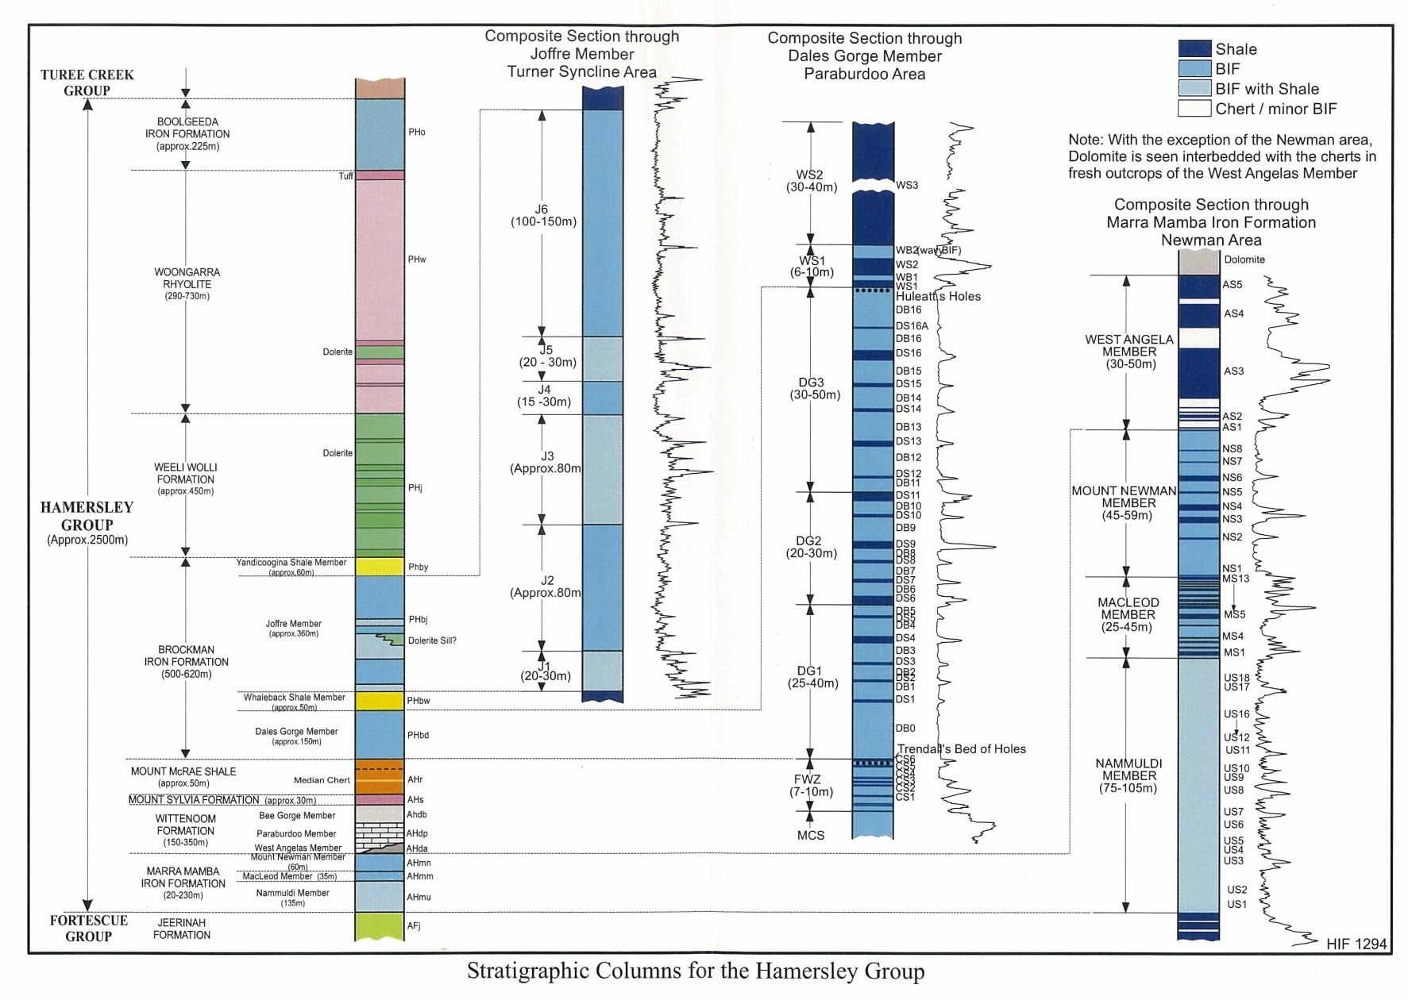
Stratigraphic interpretation – from gamma

Slide 7
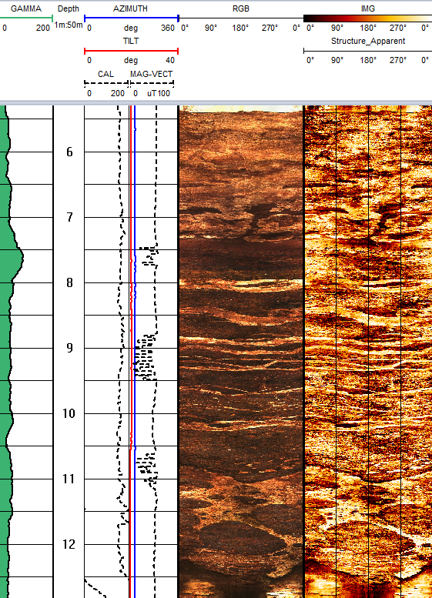
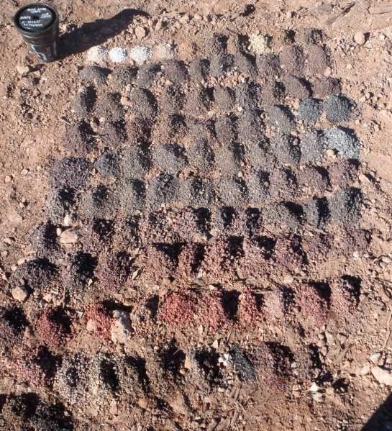
Stratigraphic interpretation – televiewers
Optical televiewer log
RC chips

Slide 8
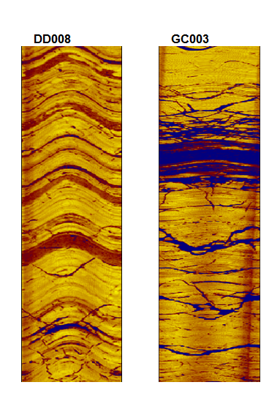
Structural interpretation – televiewers
Diamond hole
RC hole

Slide 9
Survey information – gyros & magnetic deviation
Tools used to measure the 3D geometry of the drill hole:
Magnetic deviation tools
Traditional spinning gyro
Solid state MEMS gyro
North-seeking gyro

Slide 10
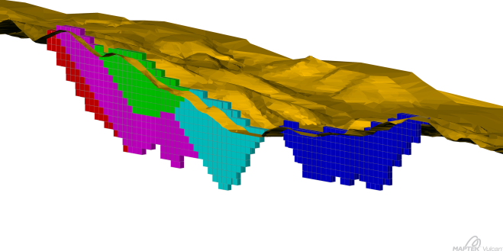
Why is density important in resource models?
Resource models defined by
Grade
Geometry (volume)
Bulk density (tonnes)
The size of resources should be reported in dry bulk tonnes.
Iron ore deposits are frequently very heterogenous meaning they can’t be accurately modelled with a “global” density.
(Lerchs, 2014)

Slide 11
Wireline gamma-gamma density logging
Caliper measures hole diameter and pushes tool against hole wall.
High energy gammas emitted from source.
Gamma’s interact with electron shells of atoms in the borehole walls.
Backscattered gammas measured by detector.
Electron density of rocks inversely proportional to gamma count.
“Calibration” formula used to convert counts to formation density.

Slide 12
Strengths and Limitation of wireline density
Wireline gamma density
Not a direct measure of formation density.
In-situ density measured (rock contains moisture).
Can be collected in RC and diamond holes.
Relatively quick and inexpensive to collect.
Large volume of data commonly available.
Traditional core density
Direct measure of formation density.
Dry bulk density measured if sample dried.
Data collection limited to diamond holes only.
Time consuming and expensive to collect.
Sample population usually very limited.

Slide 13
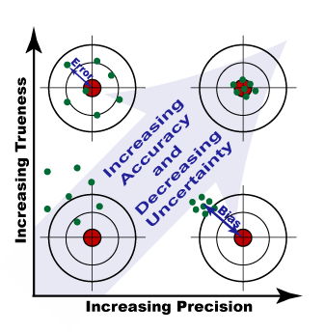
Preparing gamma density for resource estimation
Three important processes to consider:
Data precision (repeatability)
Removing erroneous data in hole washouts
Conversion to a dry bulk density equivalent by comparison against independent data

Slide 14
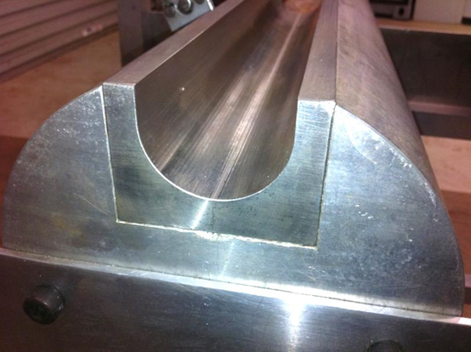
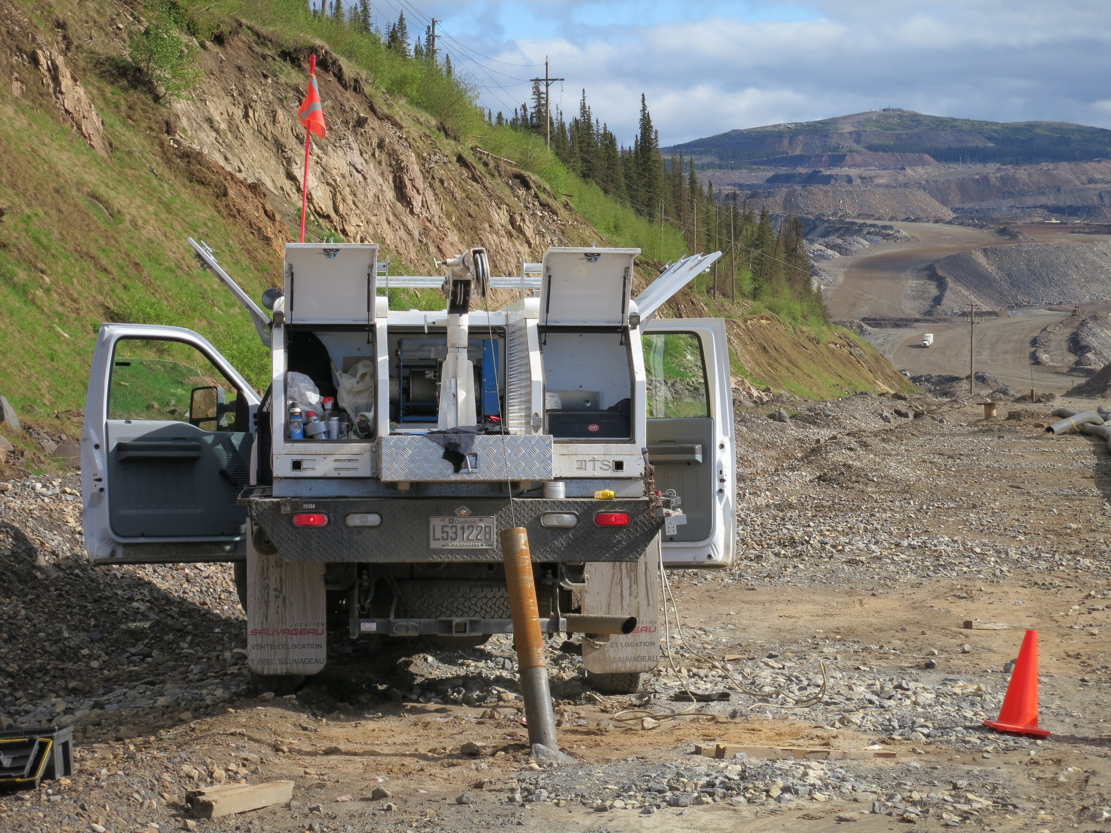
Data Precision (tool “calibration”) tests
Historically measured against jigs.
Values were found to be too low for an effective test for iron ore logging.
Generally completed against a site reference hole.
Main aim is to demonstrate internal consistency in the data.
Test is not a true “calibration”.

Slide 15
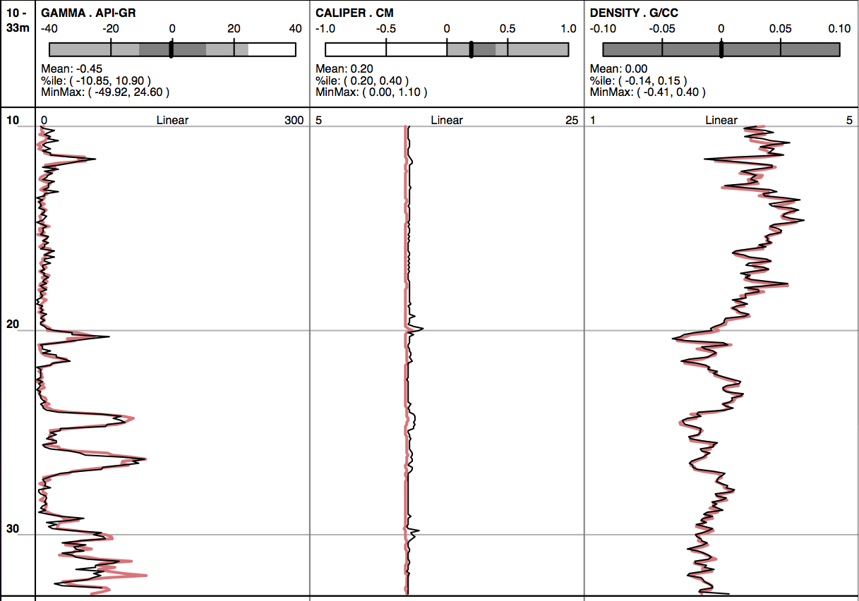
Data Precision (tool calibration) tests

Slide 16
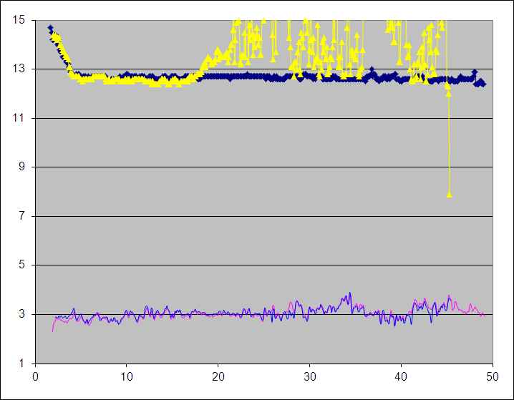
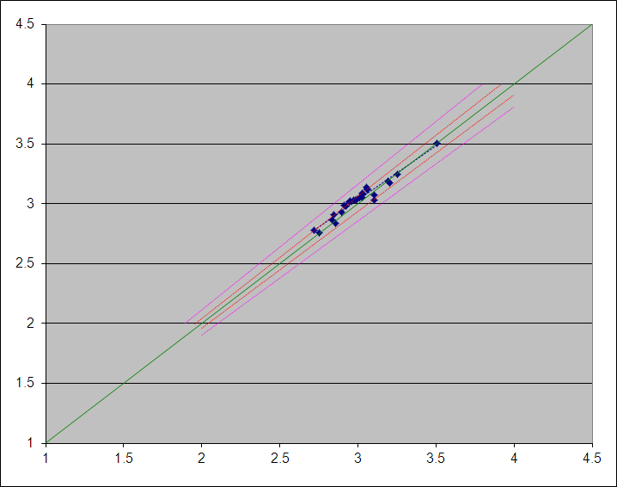
Data Precision (tool calibration) tests
Aging calibration holes can be identified from the caliper trace.
Caliper traces
Density traces
Depth
Repeat log density
Scatter plots can be useful in identifying bias in repeat hole runs.
Master log density

Slide 17
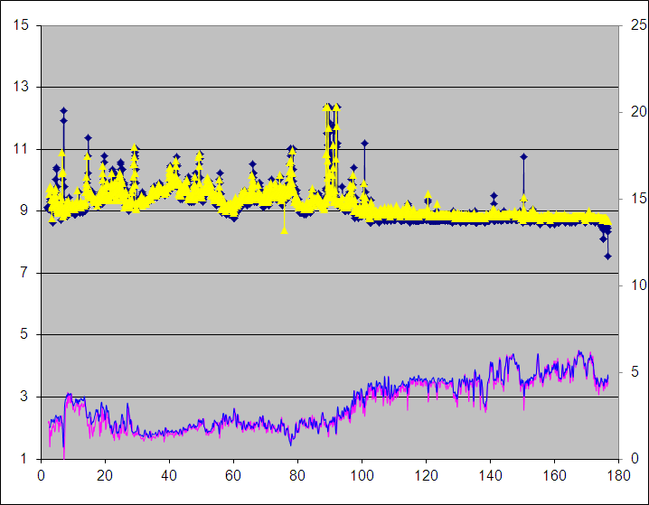
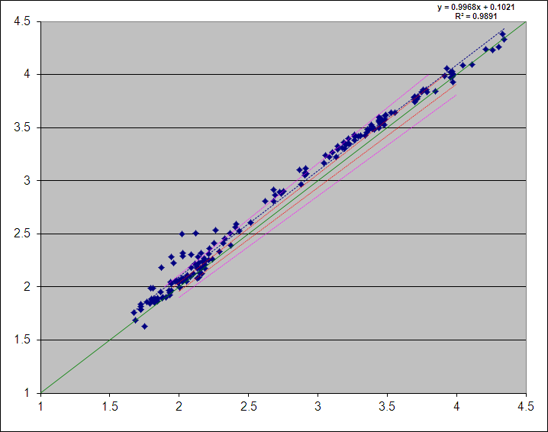
Data Precision (tool calibration) tests
A simple high point – low point test may not be enough.
Caliper traces
Density traces
Depth
Repeat log density
Master log density

Slide 18
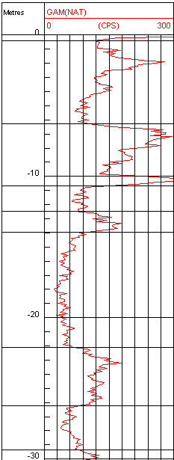
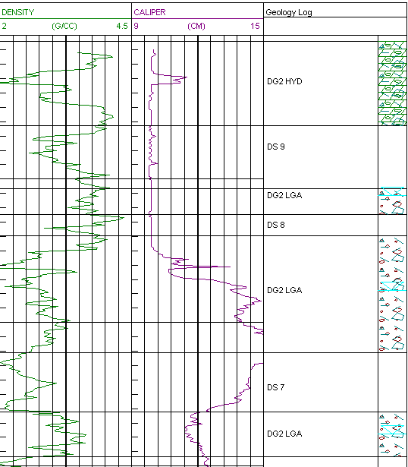
Caliper filtering of “bad” data
(Modified from Butt, 2002)

Slide 19
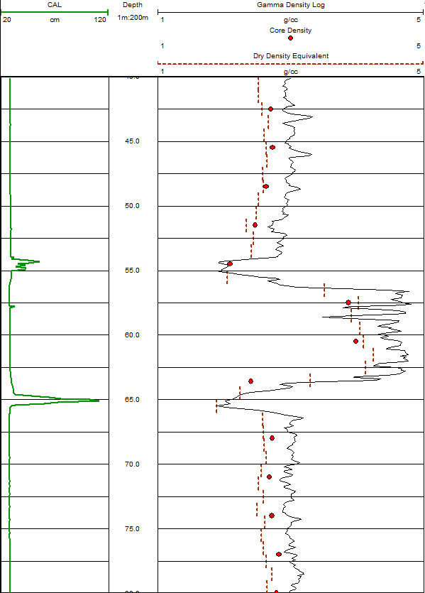
Conversion to a dry bulk density equivalent
Remove bias in gamma density measurements by normalization against dry core density.
Different analysis need to be completed to account for hole condition:
      Diamond drilling
      RC drilling
      Effect of water table

Slide 20
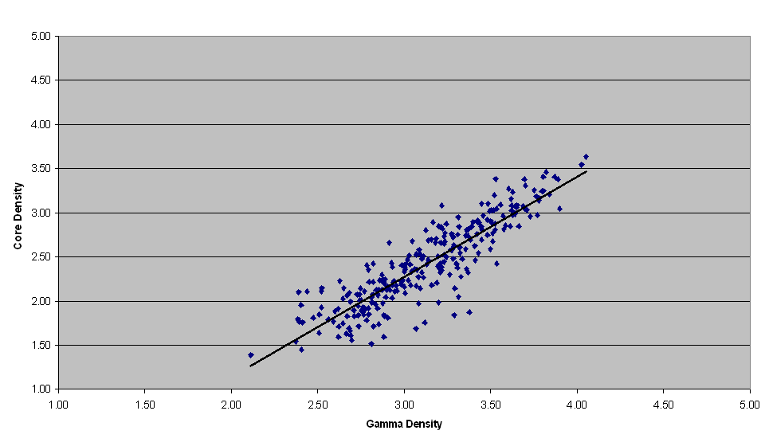

Conversion to a dry bulk density equivalent

Slide 21
Corrected gamma density vs. core
TRAY CORE MEASUREMENTS
Count: 35
Average:3.33 g/cc
Std Dev: 0.49 g/cc
TRAY CORRECTED GAMMA DATA
Count: 35
Average:3.32 g/cc
Std Dev: 0.45 g/cc
CORRECTED GAMMA DATA
Count: 774
Average: 3.19 g/cc
Std Dev: 0.48 g/cc
RC holes
Diamond holes

Slide 22
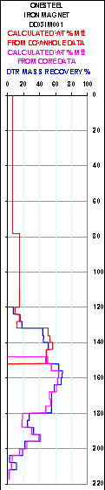
Magnetite grade estimation
(Onesteel, 2004)

Slide 23
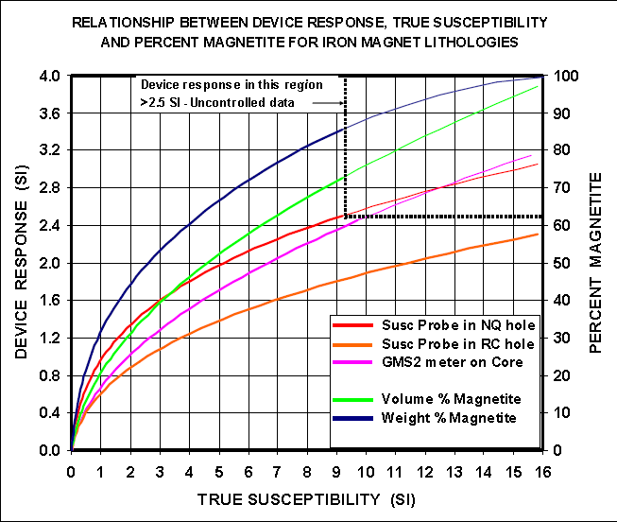
Magnetite grade estimation
(Onesteel, 2004)

Slide 24
Summary
        We collect wireline logging data to increase our understanding of orebodies and reduce our risk in resource estimation.
        Aids lithology and stratigraphic interpretation to improve geologic understanding.
        Survey logs to improve control of hole location.
        Gamma density logging greatly improved coverage of information, but must be corrected to a dry density equivalent.
        Possible grade control applications.

